Slide 1
CPU Scheduling
D. Jones
Central Queensland University
J.L. Arnott
University of Dundee
February 2014

Slide 2
CPU Scheduling
For a process to do any work it must obtain a
processor (CPU) so that its code can execute.
When does a process get CPU?
How long does it have it for?
This is decided by the scheduling algorithm.
Example: take the shortest process from the Ready Queue and put it onto the CPU and let it run to completion; short processes get to run first.

Slide 3
Types of CPU Scheduling
Scheduling is divided into various levels.
These levels are defined by the location of the processes.
A process can be -
available to be executed by the processor (e.g. Ready)
partially or fully in main memory (e.g. Ready, Blocked)
in secondary memory (e.g. Suspended)
not yet added to the system (e.g. New or not yet New)

Slide 4
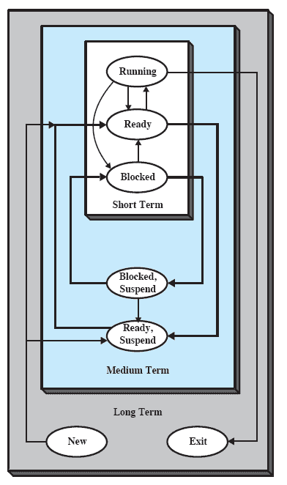
Types (Levels) of Scheduling
Long-term – decision to add to the pool of processes to be executed, e.g. admit a process onto Ready queue.
Medium-term – decision to move process into main memory (e.g. from Suspend to Ready).
Short-term – decision re which process gets onto CPU next, e.g. move a process from Ready to Running.
Decision needed whenever a process is taken off the CPU (i.e. when a process is moved from Running to Ready or to Blocked).
e.g. every time round-robin scheduler triggers a process change.
From W.Stallings: “Operating Systems”

Slide 5
Scheduling Criteria
user-oriented or system-oriented criteria
performance or other criteria
User-oriented criteria – good user experience.
  e.g. low response times & max. percentage of deadlines met.
System-oriented criteria – user is not important, what is important is the maximum efficiency and utilisation of the machine.
  e.g. max. CPU utilisation, max. system efficiency, max, no. of processes completing / unit time, low energy consumption.

Slide 6
User Experience
Those of us interested in User Experience are interested in User-oriented Criteria
  We wish to deliver a good experience to the user
Examples of what is important:
  Low response times – things happen immediately when mouse clicked, keyboard pressed, etc.
  Event deadlines need to be met so that things are happening at the right time, e.g. reminders, prompts, screen changes.
The scheduling algorithm has strong influence:
  Priority of processes
  Order in which processes are executed
  How much CPU time is given to each individual process

Slide 7
Generally
A scheduling mechanism should:
favour short jobs
favour I/O-bound jobs to get good I/O device utilisation and better interactive performance
determine the nature of a job and schedule accordingly
be “cheap” (efficient) to implement

Slide 8
Some Scheduling Algorithms
FCFS (First-Come-First-Served) or FIFO
Round Robin
Shortest Job First (Shortest Process Next)
Shortest Remaining Time

Slide 9
FCFS (FIFO)
(First-Come-First-Served, First-In-First-Out)
When the current Running process finishes,
the process at head of Ready Queue is selected next,
then it is allowed to run to completion.
Any process becoming ready joins the Ready Queue.
  Simple queuing diagram.
  A “Blocked” queue can be added for Blocked State.
Processes
Dispatch
New
CPU
Exit
Ready Queue

Slide 10
FCFS (FIFO) Queuing
Add a “Blocked” queue:
Dispatch
New
CPU
Exit
Ready Queue
Blocked Queue

Slide 11
FCFS (FIFO)
(First-Come-First-Served, First-In-First-Out)
Characteristics.
Simple to implement.
Favours long processes over short ones, because the Running process is allowed to stay Running until it completes and Exits.
Favours CPU-bounded processes, i.e. ones that are constrained by the power of the computer (e.g. CPU)
  Data processing & number-crunching programs are examples of cpu-bound processes.
FCFS is a non-pre-emptive algorithm (see later slide).

Slide 12
CPU-bound & I/O-bound
A CPU-bounded process is limited by the CPU processing power
  “CPU boundedness” of a process
  degree to which progress is defined by processing power
  Data processing, etc.
An I/O-bounded process is limited by external events (I/O, Input/Output).
  “I/O boundedness” of a process
  Degree to which progress is defined by external events
    e.g. waiting for a keystroke on the keyboard
  I/O, user interface, user-experience, etc.

Slide 13
Round Robin (RR)
Implementation.
Processes are dispatched FIFO, but are given a fixed time on the CPU (quantum/time slice).
A timer interrupt is used to provide time slicing.
Each process runs for a fixed length of time, then is forced to leave the CPU and return to the end of the queue.
It may require many visits to the CPU to complete its task and exit.
CPU time is shared out amongst the ready processes.

Slide 14
Round Robin (RR)
Each process gets 1 time slot (quantum), then execution (CPU) moves on to the next process. Goes round continuously until processes complete.
Processes are represented by coloured circles here.

Slide 15
Time Slicing -
The Interrupting Clock
The OS sets the interrupting clock to generate an Interrupt at some specified future time.
  Common for computers to have hardware timers that can generate interrupt requests – can use these as a reference timing source.
This interrupt time is the process’s quantum (time slot or time slice).
Allows the OS to regain control of the processor and then pre-empt any process.
Provides reasonable response times and prevents the system being held up by processes in infinite loops.

Slide 16
Round Robin Queuing
Time-out
Dispatch
New
CPU
Exit
Ready Queue
What is new about this queuing diagram ?

Slide 17
Round Robin Queuing with Blocked Queue
Time-out
Dispatch
New
CPU
Exit
Ready Queue
… and we can add a Blocked Queue.
Blocked Queue

Slide 18
Round Robin (RR)
Effective in time-sharing environments.
  Popular algorithm when time-sharing, multi-tasking is required.
  Used, for example, in Microsoft® WindowsTM.
Round Robin penalises I/O-bound processes because they often block quickly, waiting for an I/O event
  so they make less use of their time slice than CPU-bound ones do.
  an I/O bound process is one that interacts with the outside world and may have to wait every so often for an external event to happen before it can proceed;
  in other words, it can get “blocked” by (the absence of) an external event such as a key press or mouse action.
RR is a pre-emptive algorithm (see later slide).

Slide 19
Round Robin Queuing with Two Blocked Queues
Time-out
Dispatch
Admit
CPU
Exit
Ready Queue
… indeed we can add a Blocked Queue for every device that can cause blocking.
I/O 1 wait
I/O 1 occurs
I/O 2 wait
I/O 2 occurs
Blocked Queues

Slide 20
What is Pre-emption ?
Pre-emption is “butting-in” or interrupting the execution of program code.
If the Op Sys is able to stop the process executing and take the CPU away from that process, this is described as “pre-emption”. Process execution is thus paused.
Pre-emptive: a scheduling algorithm is pre-emptive if the Op Sys can take the CPU away from a process.
  The Op Sys regains control of the computer by pre-empting the Running process and returning that process to the Ready Queue.
  The OP Sys is then in a position to decide what happens next.

Slide 21
Non-pre-emptive or
Pre-emptive Scheduling ?
Pre-emptive: a scheduling algorithm is pre-emptive if the Op Sys can take the CPU away from a process.
Non-pre-emptive: a scheduling algorithm is non-pre-emptive if the Op Sys is not allowed to take the CPU away from a process.
Pre-emptive scheduling is useful in a situation where there is a high number of high priority processes.
  The Op Sys can prevent one process from starving other processes by pre-empting that process and returning it to the Ready state.

Slide 22
Shortest-Job-First (SJF)
Sometimes known as Shortest Process Next (SPN).
Implementation
The process with the shortest expected execution time is dispatched first to the processor.
Characteristics
Non-pre-emptive (so not for a time-slicing system).
Reduces average waiting time compared to FCFS.
Must know in advance how long a process will run for.
Possible user abuse (e.g. under-estimating the run-time).
Long processes may get starved by short ones.

Slide 23
Shortest Remaining Time (SRT)
Pre-emptive counterpart of SPN (SJF).
Implementation
Process with the smallest estimated run-time to completion is run next.
A running process may be pre-empted by a new process with a shorter estimated run-time.
Characteristics
Still requires estimates of the future run-time.
Higher overhead than SJF (SPN).
No additional interrupts are generated as in RR.
Elapsed service times must be recorded.

Slide 24
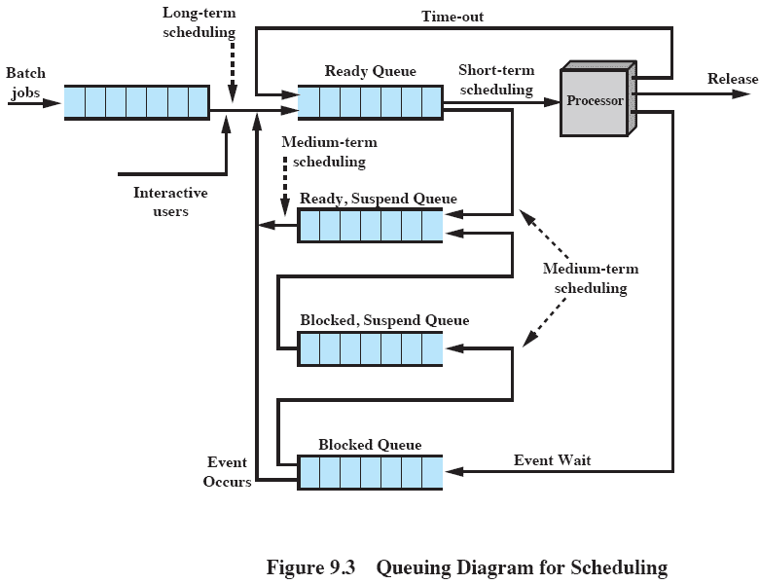
Queuing
Shows where the Long-term, Medium-term and Short-term scheduling decisions are relevant.
From W.Stallings: “Operating Systems”

Slide 25
A Little Light Scheduling ...
The following processes (Pn) exist at time 0, each with a total run-time requirement of T units:
P0 (T=7), P1 (T=13), P2 (T=5), P3 (T=3), P4 (T=2)
Draw a Gantt chart that illustrates when each process runs when using the following types of scheduling: (i) SJF(SPN); (ii) RR.
For each of these types of scheduling, calculate:
how much time each process spends waiting;
the average waiting time for all the processes.
If time-slicing is used, assume the quantum = 1 time unit. Assume that no blocking events will occur.

Slide 26
Example Solution
A simple Gantt chart for scheduling based on process number (i.e. processes are run in their numerical order rather than SPN, RR, etc.) looks like:
Process Waiting time
P0:******* 0
P1: ************* 7
P2: ***** 20
P3: *** 25
P4: ** 28
Time: 7 20 25 28 30
Average waiting time = (0+7+20+25+28)/5 = 16

Slide 27
Process Arrival Time
Processes are not likely to arrive at exactly the same time.

Slide 28
Process Arrival Time
Processes are not necessarily admitted to the Ready Queue at the same time.
  Some “arrive” in the Queue later than others.
  Arrival time can determine when process runs (FIFO, etc.).
So if processes (Pn) arrive at times A_{n}, each with a total run-time requirement of T units:
P0 (T=7, A=16), P1 (T=13, A=0), P2 (T=5, A=9), P3 (T=3, A=12), P4 (T=2, A=3)
  we would get the execution sequence on the next slide.

Slide 29
Example Solution – Arrival Times
A simple Gantt chart for scheduling based on process number (i.e. processes are run in their numerical order rather than SPN, RR, etc.) looks like:
Process Waiting time
P0: | ******* 2
P1:************* 0
P2: | ***** 4
P3: | *** 13
P4: | ** 25
Time: 13 18 25 28 30
Average waiting time = (2+0+4+13+25)/5 = 8.8
| = Pn arrival

Slide 30
Process Priority
Processes and threads of different priority

Slide 31
Priority
Processes can have different priority
High priority processes & threads
  Interactive input/output (I/O).
  User interface – the user experience must come first.
  Urgent and important – must happen quickly.
Medium priority processes & threads
  Disc access for periodic data saving (e.g. WORD).
  Less important/urgent than user interface & user experience.
Low priority processes & threads
  Background process, e.g. data processing , virus scanning.
  Can run slowly over a long period of time but should not intrude on the user experience.

Slide 32
Priority
Processes of different priority
Time-out
High Priority Q
Dispatch
Admit
Medium Priority Q
CPU
Exit
Low Priority Q
Ready Queues
Can have more than one READY Queue; have as many READY Queues as separate priority levels which are needed.

Slide 33
Priority
A policy is needed
Scheduling algorithm will need to have a policy, e.g.
Which queue to access next, e.g.
  Take all processes from HIGH PRIORITY Q till empty, then empty the MEDIUM Q, then empty the LOW PRIORITY Q
    But danger that MEDIUM and LOW processes will starve.
  OR
  Take 3 processes from HIGH, 2 from MEDIUM, 1 from LOW;
  Gives MEDIUM and LOW a good share of the action.
  OR
  Take 10 processes from HIGH, 4 from MEDIUM, 2 from LOW.
  Gives MEDIUM and LOW some action, HIGH gets the most.
  ETC.

Slide 34
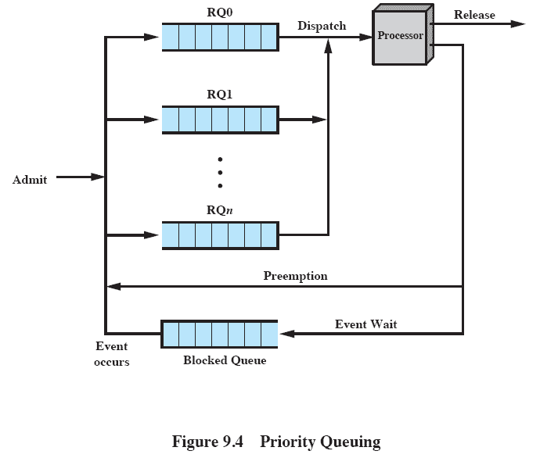
Priority Queues
Once pre-empted, a process/thread can return to its usual Ready Q.
So a process or thread leaving the processor can follow the pre-emption path back to the Qs, but be placed on a different Q than the one it came from.
It thus has its priority changed.
This arrangement also allows for processes/threads to migrate to other Ready Qs, i.e. their priority can change if O.S. wants it to change.
From W.Stallings: “Operating Systems”

Slide 35
Thread Dispatching Priorities in Microsoft Windows
Priority queuing with dynamic priority

Slide 36
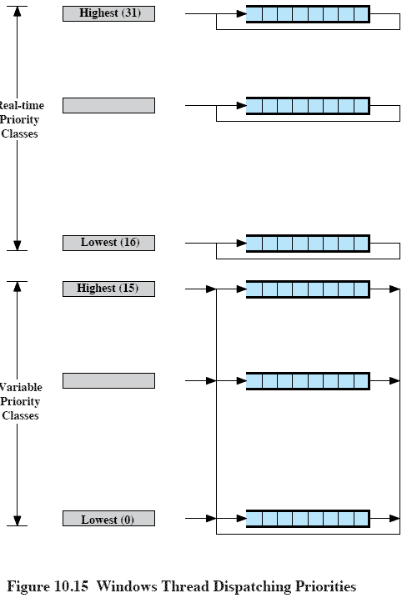
MS WindowsTM Thread Dispatching Priorities
32 priority Ready queues
  16 Real-time priority classes (top)
  16 Variable priority classes (lower)
Threads cannot move between Real-time and Variable Priority classes
Threads can migrate up and down the variable priority queues (priority levels)
  But not the real-time queues
Pre-emptive scheduling; threads with real-time priorities have precedence over others; if a thread becomes ready with a higher priority than the Running one, then it pre-empts the Running one.
From W.Stallings: “Operating Systems”

Slide 37
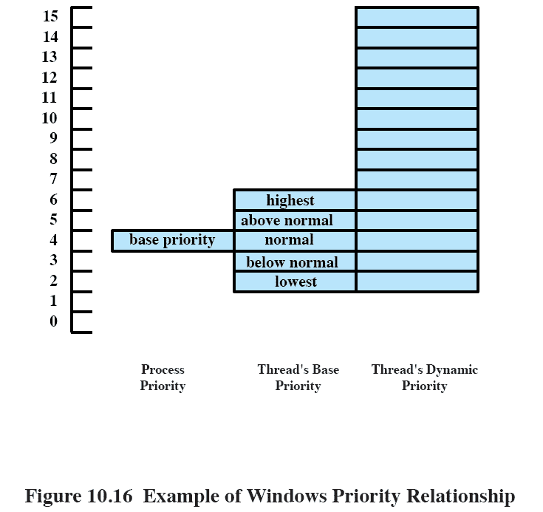
MS Windows Priority
Relationship
Process has a base priority of P.
Each thread in the process starts off with base priority of
P plus-or-minus 2.
If a thread blocks on an I/O event, its priority is boosted;
If interactive, it is boosted more.
If it is cpu-bound, priority is reduced.
Thread can migrate up and down this column dynamically.
But does not drop below its own thread base priority or rise higher than level 15.
From W.Stallings: “Operating Systems”

Slide 38
Microsoft Windows
Microsoft Windows was designed for use as a single-user, interactive, time-sharing, multi-programming environment.
The user experience is therefore important so
  The system must be responsive to the user.
The thread scheduling has therefore been designed to assist:
  Interactive (e.g. keyboard, mouse) threads the most;
  other input/output (e.g. disk I/O) threads next;
  CPU-bound (e.g. data processing) threads the least.

Slide 39
End of Slide Sequence

Slide 40
Addenda
Additional optional material

Slide 41
Virtual Round Robin (VRR)
A modification to the RR algorithm to remove the bias towards CPU-bound processes.
Implementation
Two “ready” queues, one called AUXiliary for storing I/O processes once they are released from their wait (i.e. become unblocked and leave the blocked state).
AUX queue has priority over READY queue.
I/O Processes from AUX only run for their remaining time, not for a full time slice.
Characteristics
Performance studies indicate that this is fairer than RR.

Slide 42
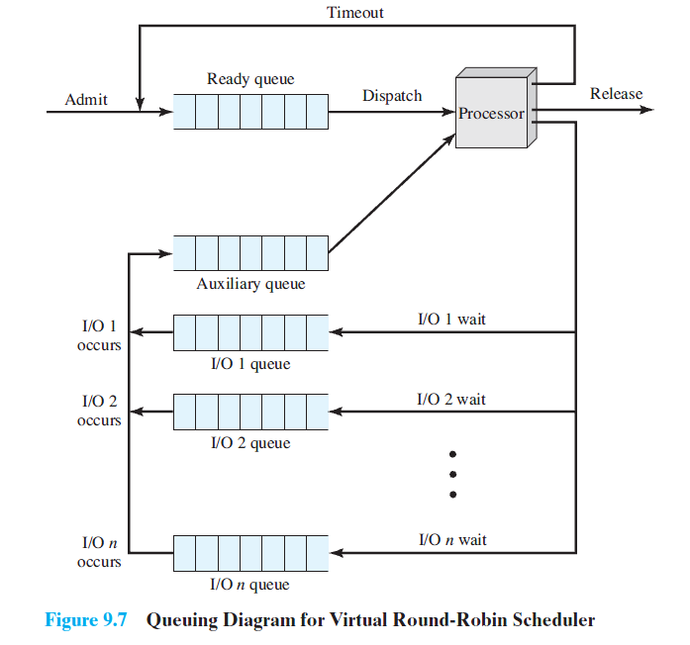
Ref: Stallings “Operating Systems”, Ed. 7

